Slide 1
Update on the Relocation of NSF Headquarters
Business and Operations Advisory Committee
November 29, 2016
Dr. Joanne Tornow
Brian MacDonald

Slide 2
Project Overview
NSF relocating to Alexandria in 2017
  Moving 2,250 people
  Moving into brand new building
  NSF located under one roof
  Relocate between August and October 2017
  Rent reduced by $6 million per year

Slide 3
Helping NSF achieve its mission
New Panel Conference Center
  37 conference rooms accommodating 1,200 people
  Modern AV capabilities
  Visitor Center, Business Lounge, Pre-Function Area
Work from anywhere in the building
  Robust Wi-Fi, print to any printer, VoIP system
Improves NSF’s compliance with various federal mandates, statutes, and Executive Orders.

Slide 4
Helping NSF achieve its mission
NSF controls building security
  Dedicated NSF parking garage w/controlled access
  NSF-only vs. public space
Improved building design
  Smart elevator system reduces wait times by 60%
  Improved energy efficiency (LEED Silver certification)
  Employee amenities (full service cafeteria, fitness center)

Slide 5
Project Timeline
WE ARE HERE

Slide 6
Schedule and Budget Update
Project is on schedule
  Data Center complete & commissioned
  5th floor construction 95% complete
  Employee workspace and furniture selections complete
  Absorbing schedule slippage
  Sequence of moves established
Project costs are trending slightly below budget
  Upcoming high value procurements
  Sufficient contingency remaining

Slide 7
Managing Risks
Integrated Project Schedule
  Tracking critical path activities
Business operations readiness
  Collaborating across OIRM
Partnering with BFA

Slide 8
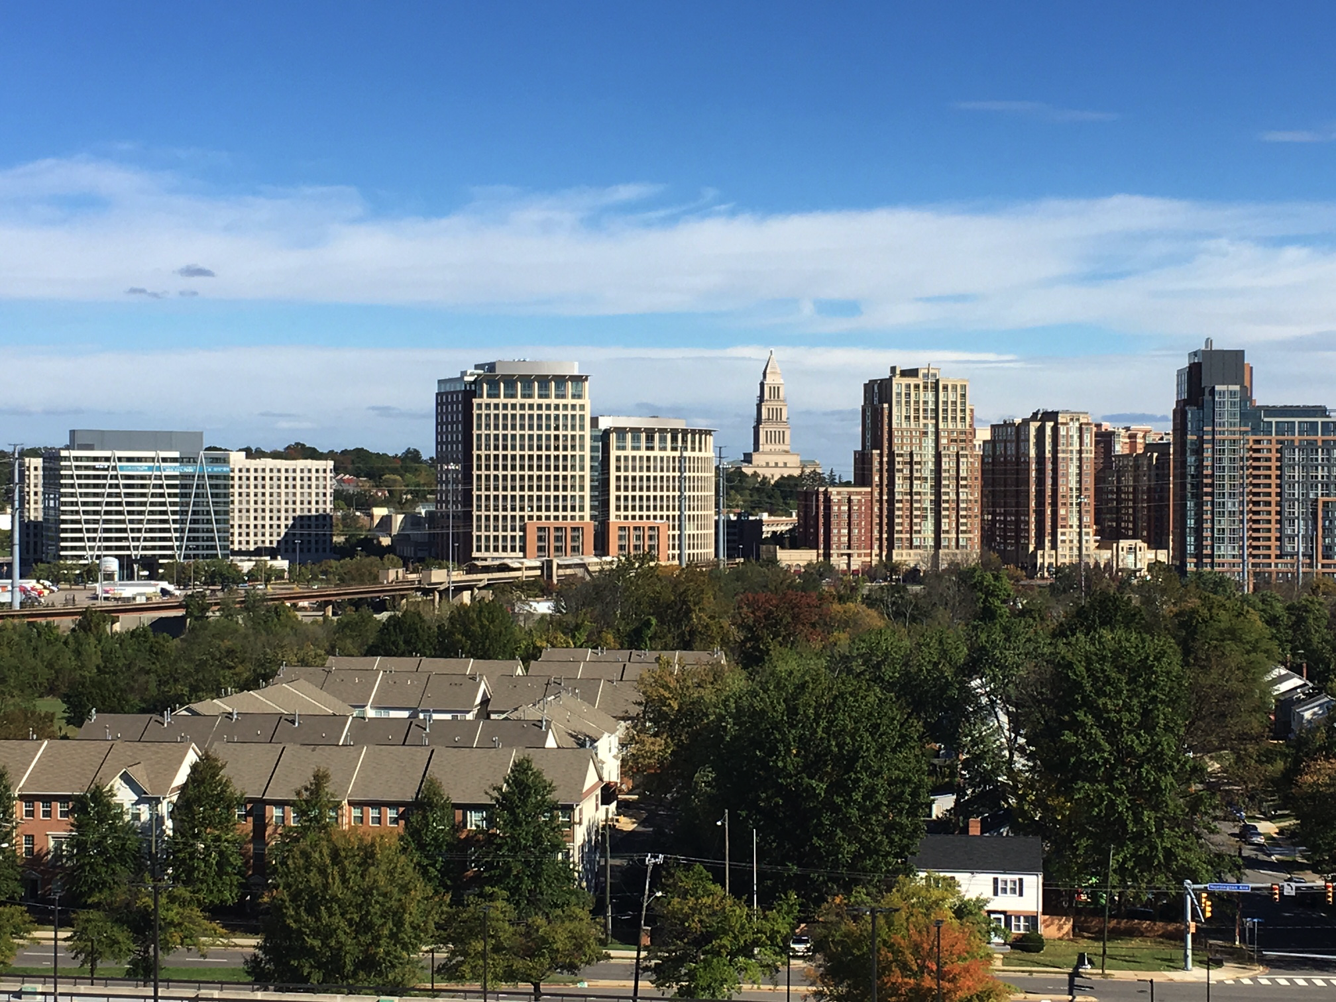
Building Skyline

Slide 9
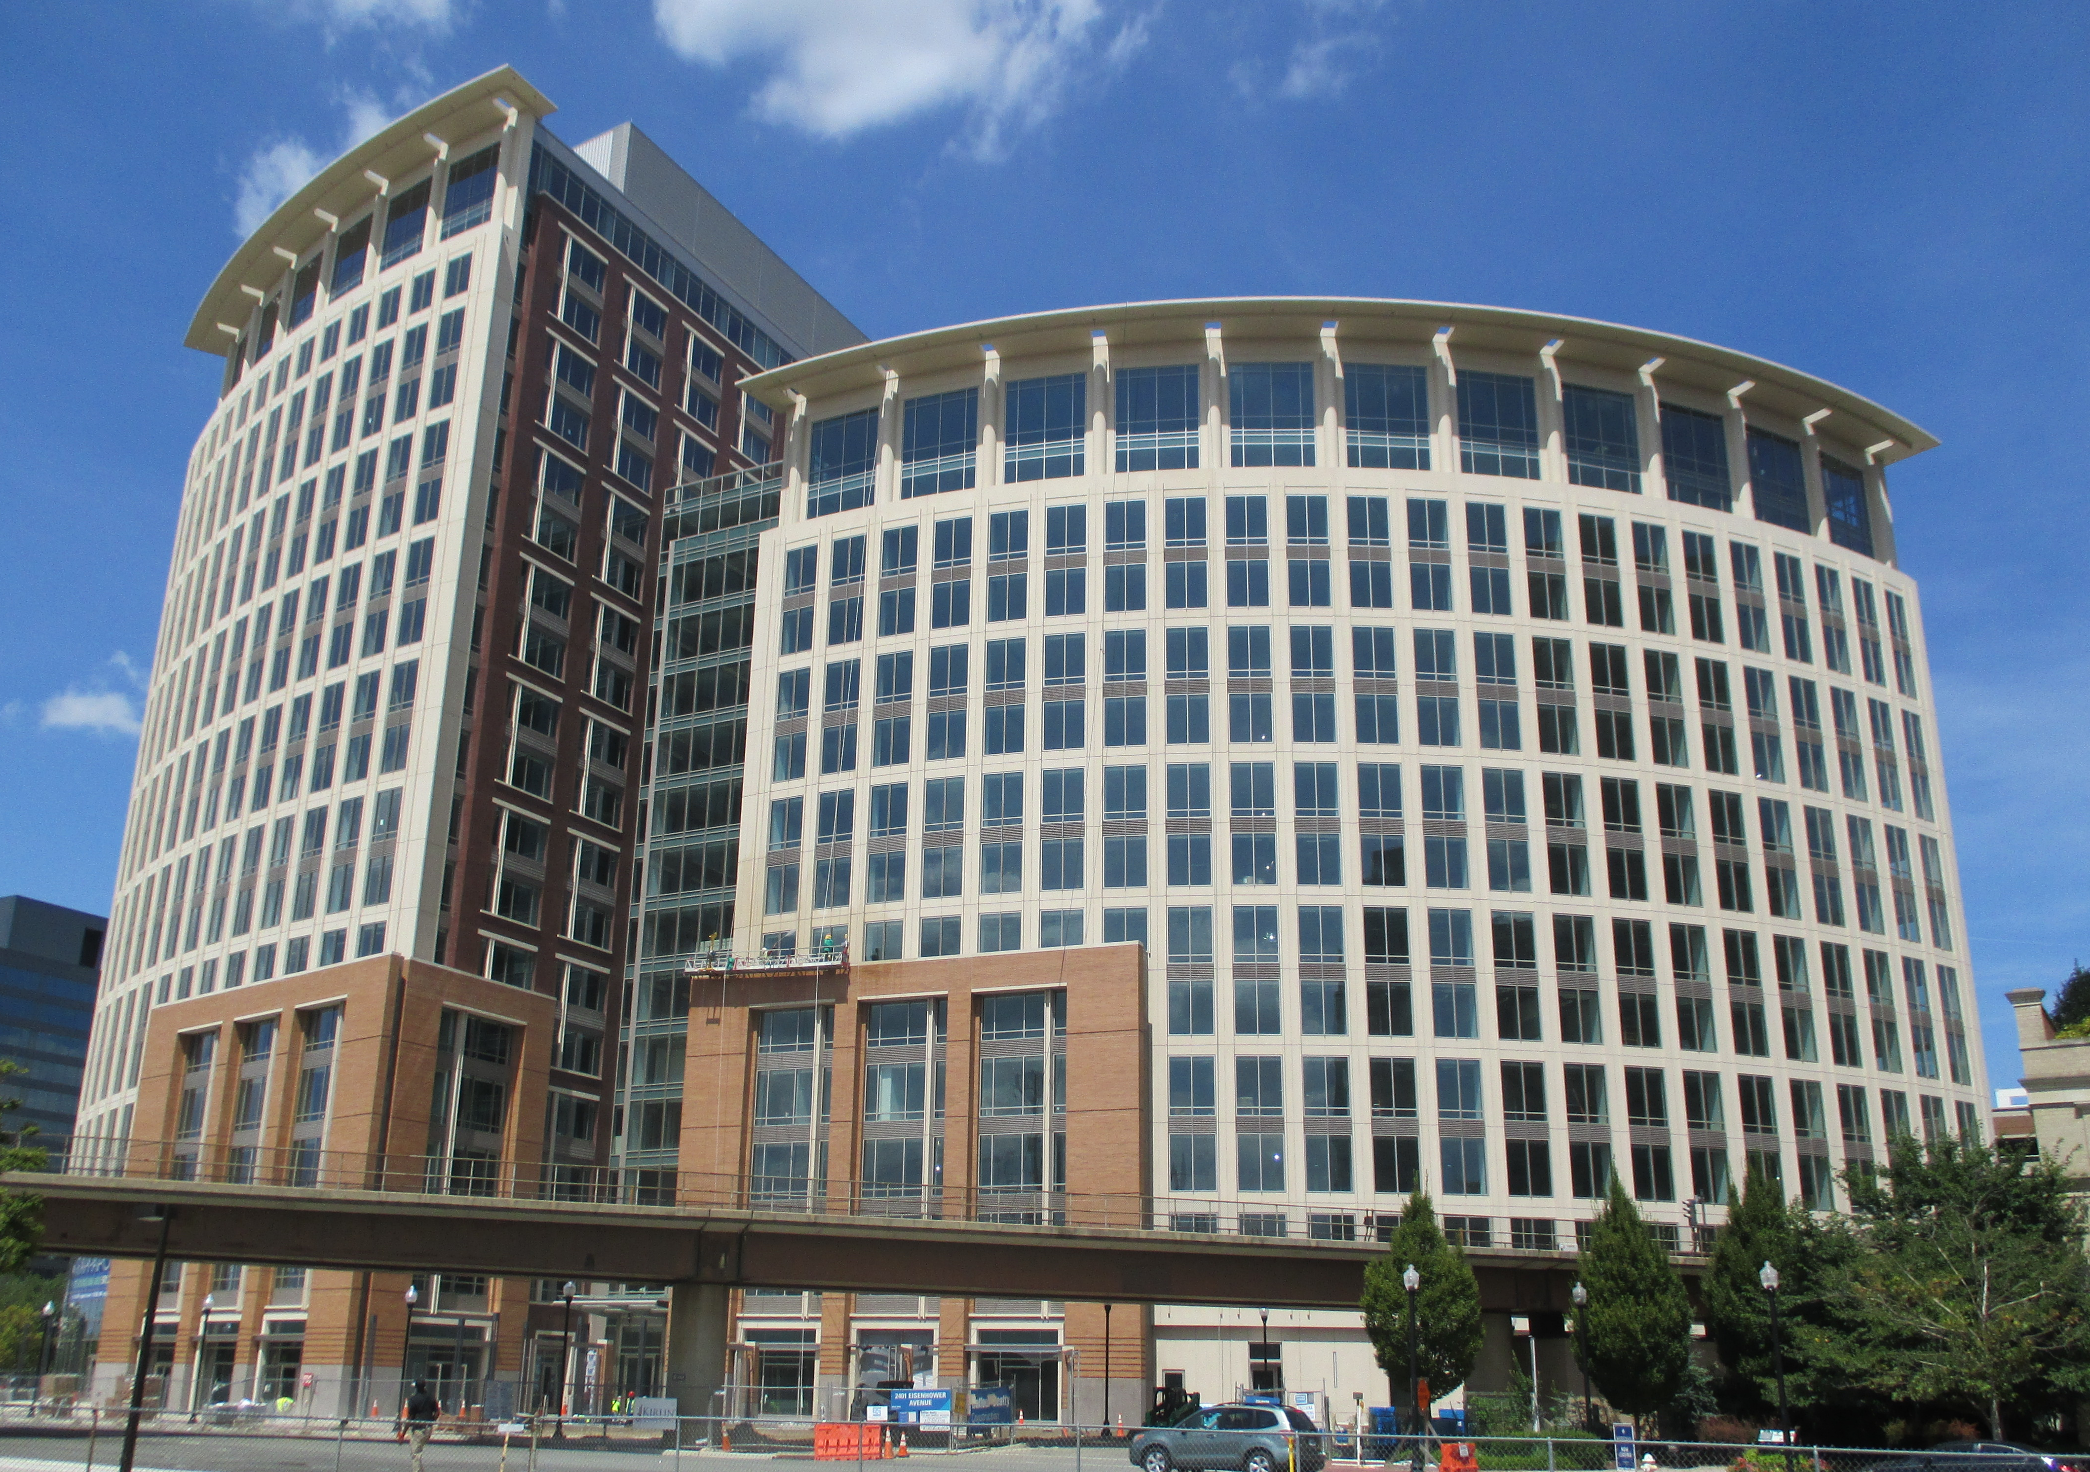
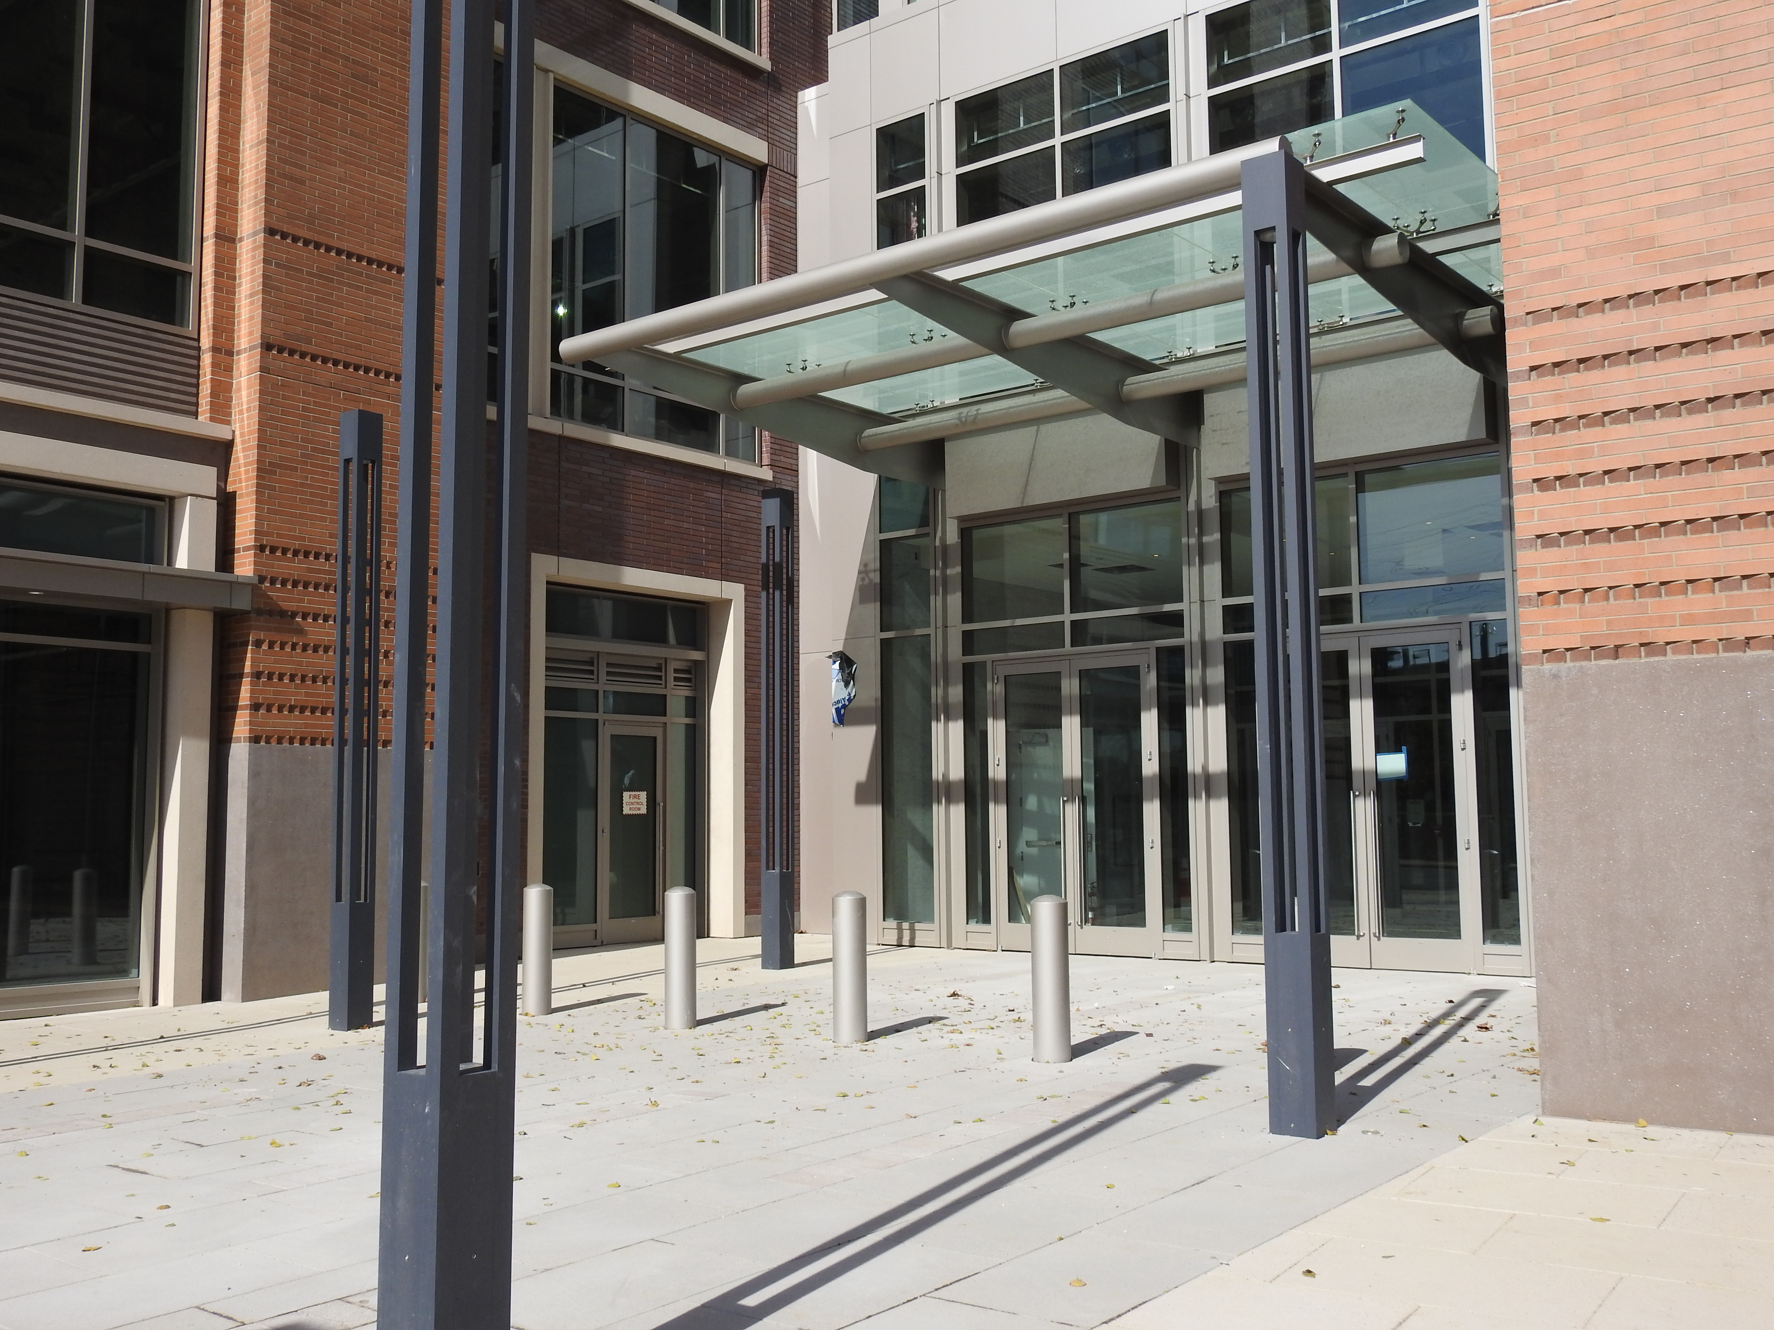
Building Exterior

Slide 10
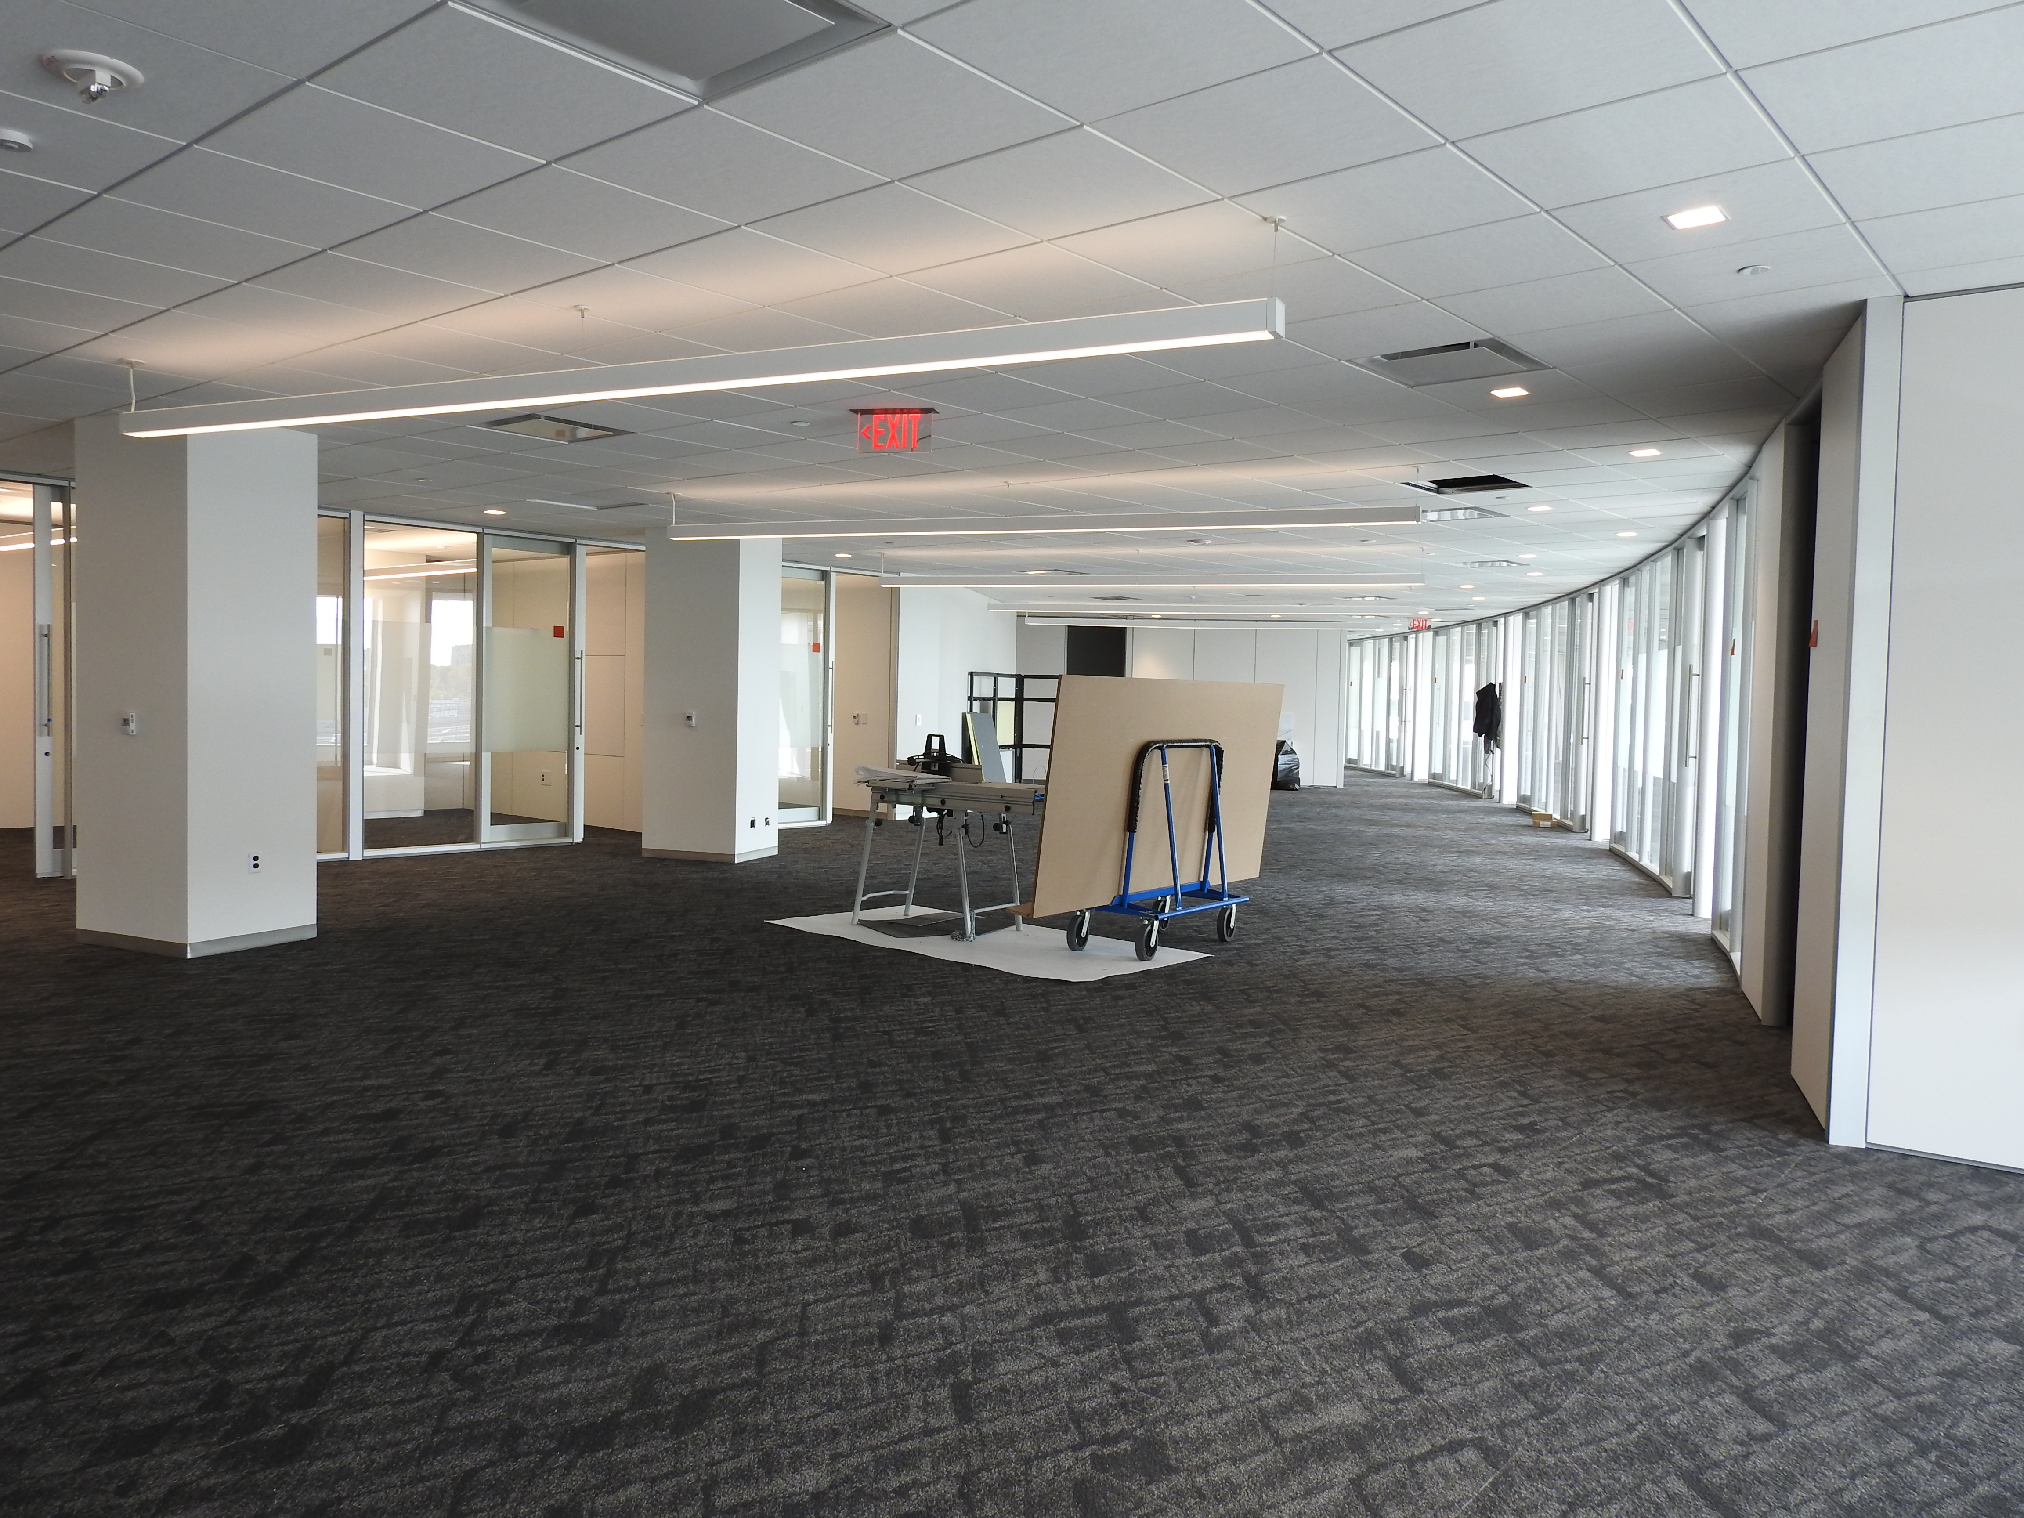
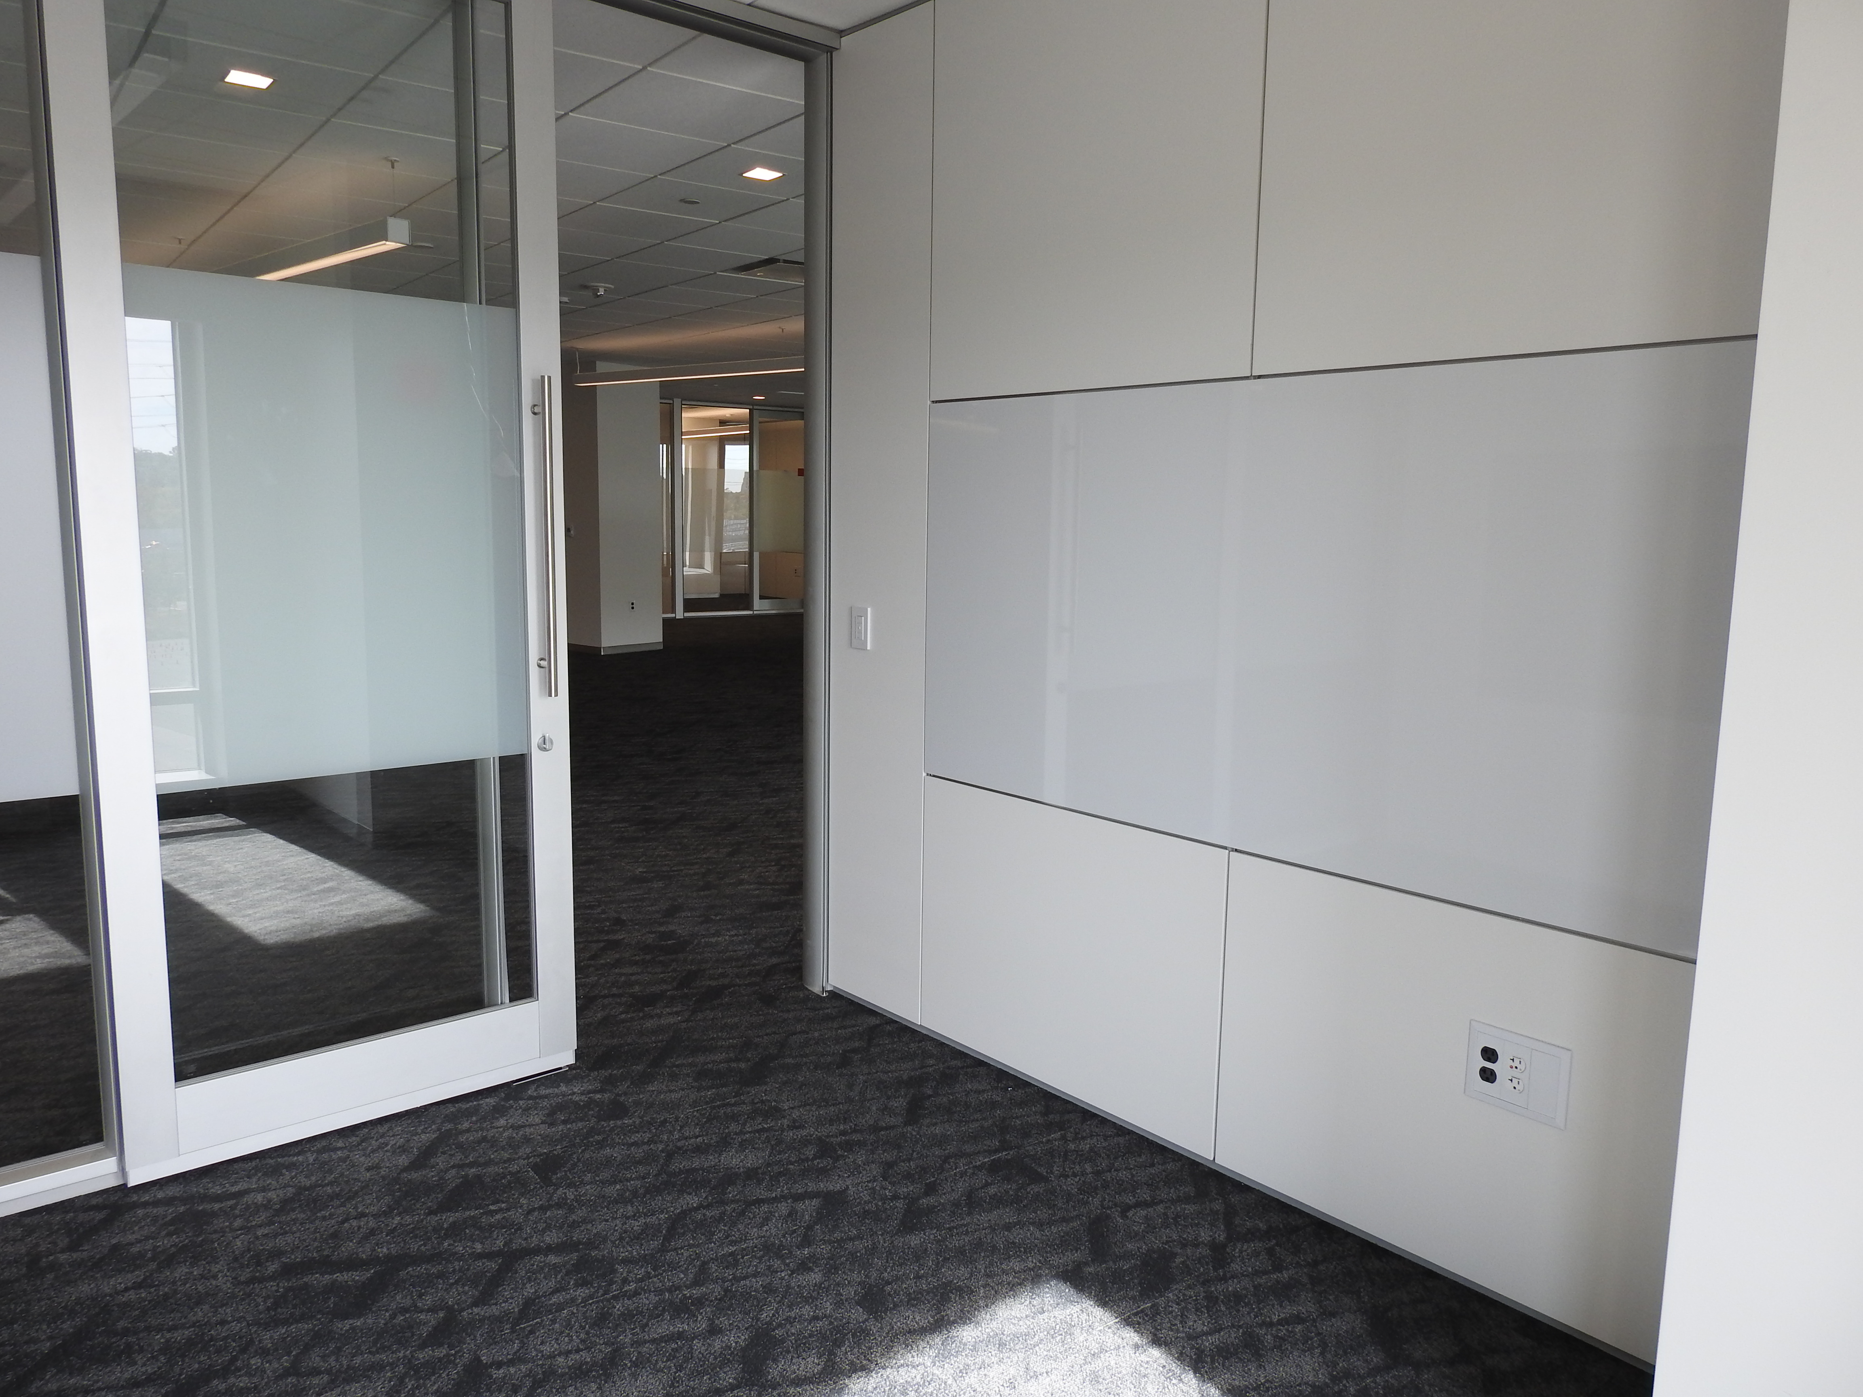
5th Floor

Slide 11
Change Management/Communications
FY16 FEVS: 74% satisfied with communications about the move
Integrated communications team
Connecting to the new building:
  Relocation resources on Inside NSF
  Workspace selection
  Monthly bus tours to vicinity
  Directorate branding
  Video tour
  Plan to initiate building tours in late winter 2017

Slide 12
Directorate Branding

Slide 13
Directorate Branding

Slide 14
Video Tour

Slide 15
What happens after we get there?
What do we need to start doing now to prepare for post-move?
  Avoiding let-down for staff responsible for all aspects of relocation.
  Best practices for agency staff to adjust to new surroundings/new processes.

